Slide 1
API
Application programming Interface

Slide 2
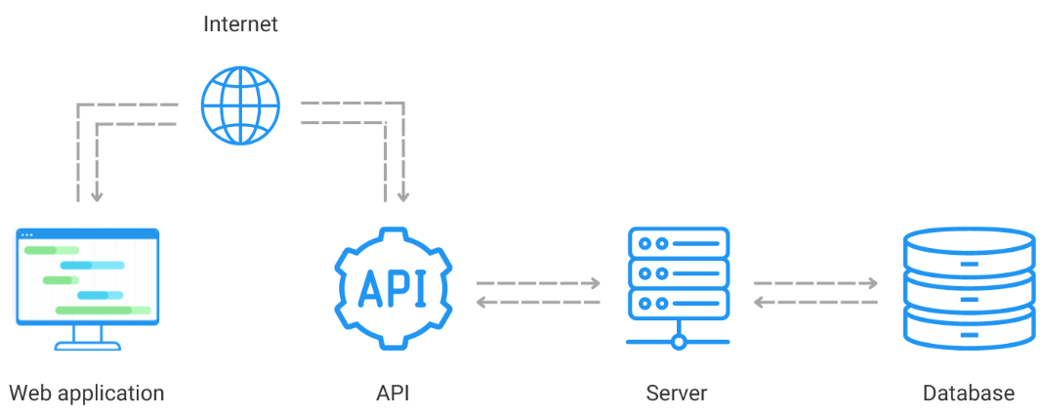
API
They are the backbone of the modern architecture because they allow for applications to be modular and decoupled.
An API is a software intermediary that allows two applications to talk to each other.
An API takes a request from an application and sends it to a server. The server then processes the request and send the data back to its application. The application then interprets the data and presents it to the user.
API can use different styles: REST, SOAP (XML-based messages), GraphQL (Queries and mutations), gRPC (Remote procedure calls), etc

Slide 3
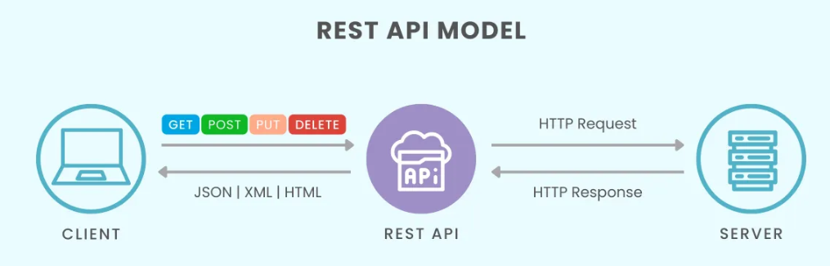
RESTAPI
(Representational State Transfer API)
A REST API is an architectural style for building web services that allows communication between client and server using standard HTTP methods.
Key Characteristics:
Stateless → Each request is independent; the server doesn’t store client state.
Client–Server Separation → The client (frontend) and server (backend) work independently.
Uniform Interface → Uses standard HTTP methods like GET, POST, PUT, DELETE.
Returns data in JSON format
All REST APIs are APIs, but not all APIs are REST APIs.

Slide 4
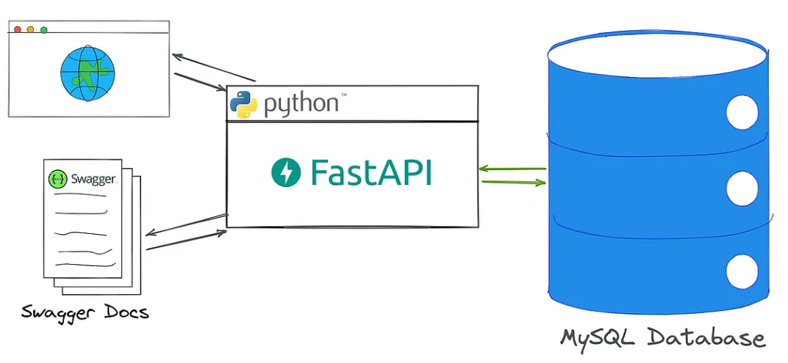
FastAPI
FastAPI is a modern, high-performance web framework for building APIs with Python 3.6+ based on standard python type hints. Developed by Sebastian Ramirez in Dec. 2018. FastAPI 0.68.0 is the currently available version.
FastAPI is built on top of Starlette web server and also includes features that make building web applications easier, such as automatic data validation, error handling and interactive API docs.
Characteristics:
Performance: On par with NodeJS and the Go language.
Speed: Increase the development speed 2-3X.
Easy: Great editor support. Completion everywhere. Easy to learn and use.
Robust: Production-ready code with automatic interactive documentation.
OpenAPI based: Fully compatible with OpenAPI and JSON Schema.

Slide 5
FastAPI vs REST API
Aspect | REST API | FastAPI
Definition | An architectural style for designing APIs | A Python web framework to build REST APIs and more
Scope | Conceptual → Defines principles (stateless, resource-based, HTTP methods) | Practical → Provides tools to implement APIs easily
Protocol | Uses HTTP (GET, POST, PUT, DELETE, etc.) | Uses HTTP but also supports WebSockets & GraphQL
Data Format | Typically, JSON or XML | JSON (default), but flexible with other formats
Performance | Depends on framework/language used | Very high → built on Starlette + Pydantic with async support
Documentation | Not inherently provided | Auto-generates OpenAPI & Swagger docs
Use Case | A guideline for designing APIs | A modern framework to build APIs following REST (and more)

Slide 6
Django, flask, and FastAPI
Django → Full-stack framework (batteries included)
Flask → Lightweight & flexible (microframework)
FastAPI → Modern, async-first, and optimized for high-performance APIs.
Aspect | Django | Flask | FastAPI
Type | Full-stack framework | Microframework | Modern API framework
Primary Use | Complex web apps (with ORM, admin, templates) | Lightweight web apps & APIs | Building high-performance REST APIs & async apps
Ease of Use | Steeper learning curve (many built-ins) | Very simple & minimal | Easy, intuitive, but requires async knowledge
Performance | Moderate (sync-based) | Better than Django (lighter) | Highest (async, built on Starlette + Pydantic)
Flexibility | Opinionated, comes with predefined structure | Very flexible, build-your-own | Flexible, focuses on APIs, less opinionated
Documentation | Excellent | Good | Excellent (auto-generated API docs)
Community Support | Very large & mature | Large | Growing fast
Best For | Large-scale, feature-rich apps | Prototyping & small apps | Modern, scalable APIs (microservices, ML backends)

Slide 7
Install FastAPI
To install FastAPI, we can use pip installer.
pip3 install fastapi
FastAPI depends on Starlette and Pydantic libraries, hence they also get installed.
Installing Uvicorn
FastAPI does not come with any inbuilt server application. To run FastAPI app, we need to install ASGI server called Uvicorn. We can install it using pip.
pip3 install uvicorn
It will also install uvicorns dependencies - asgiref, click, h11, and typing-extensions.
The application is launched on the Uvicorn server with the following command −
Uvicorn main:app reload
Where main is name of the python file, and app is the object in the FastAPI class.
Uvicorn is a lightweight ASGI server to run FastAPI apps, it is needed because FastAPI uses
ASGI (unlike Django, Flask with WSGI)

Slide 8
Hello world program
The first step in creating a FastAPI app is to declare an application object of FastAPI class.
from fastapi import FastAPI
app = FastAPI()
The app object is the main point of interaction of the application with the client browser. The uvicorn server uses this object to listen to client's request.
The next step is to create a path operation. A path is a URL that a client can visit.
When the client visits this URL with a specific HTTP method (GET, POST, etc.), a linked function runs.
This linking of a function to a path + method is called a path operation.
Example: index() function is mapped to the / path with the GET method.
@app.get("/")
async def index():
return {"message": "Hello World"}
The function returns a JSON response; however, it can return dict, list, str, int, etc. It can also return Pydantic models.

Slide 9
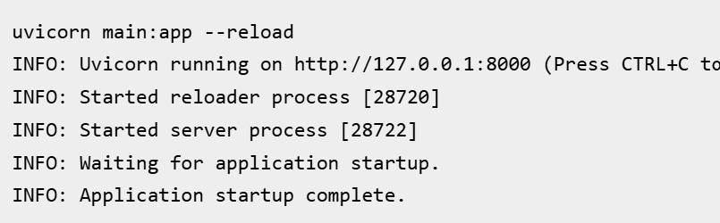
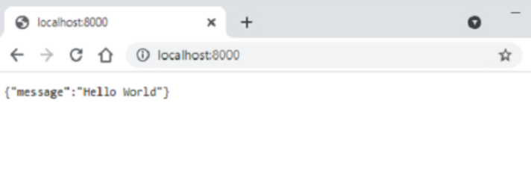
We need to save the code as py extension, e.g., main.py
from fastapi import FastAPI
app = FastAPI()
@app.get("/")
async def index():
return {"message": "Hello World"}
Start the uvicorn program by mentioning the file in which the FastAPI application object is instantiated.
Uvicorn main:app –-reload
Open the browser and visit http://localhost:/8000. You will see the JSON response in the browser window.

Slide 10
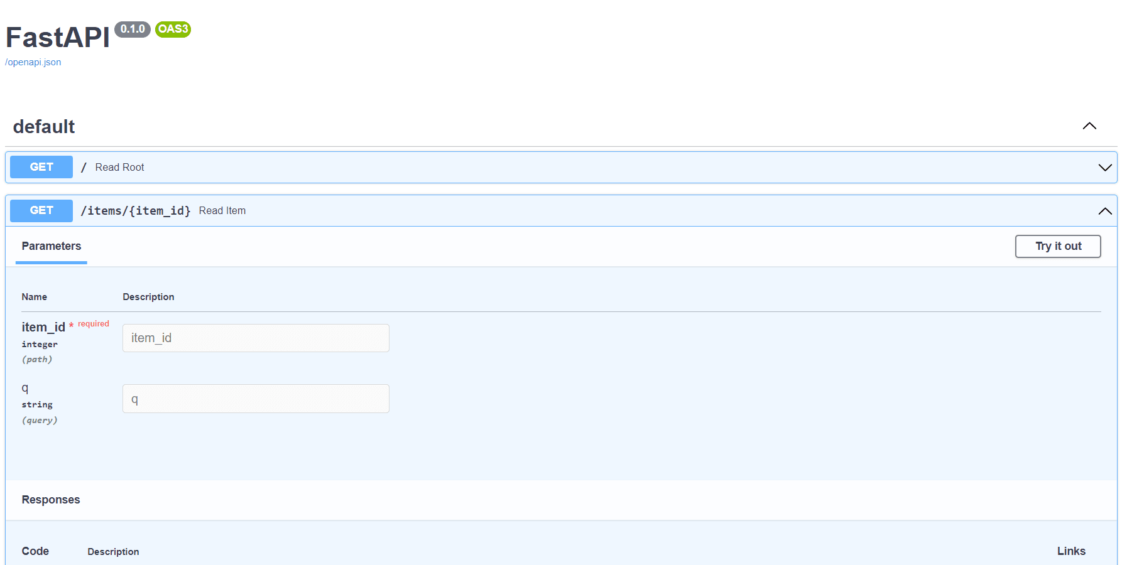
OPENAPI or Interactive API docs
To see the documentation, just add `/docs` to the url (`http://127.0.0.1:8000/docs`). This link will show automatic interactive API documentation.
OpenAPI Schema in FastAPI
FastAPI creates a schema (blueprint) of all APIs using the OpenAPI standard.
A schema is an abstract description of the API (not the code).
This schema powers the built-in interactive docs (Swagger UI & ReDoc).
Click the 'try it out' button and then 'Execute' button that appears afterward.

Slide 11
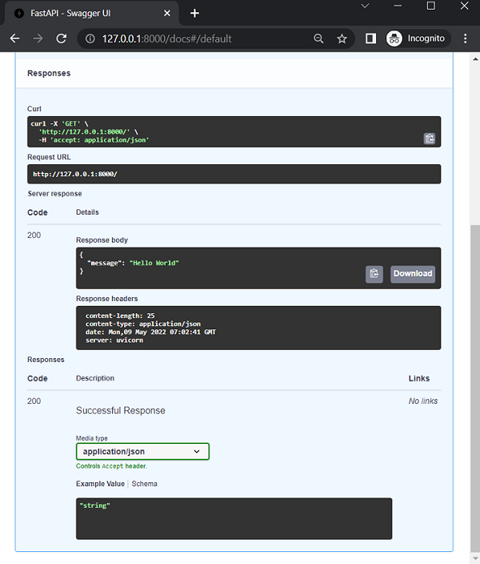
The Curl command internally executed, the request URL, the response headers, and the JSON format of the server's response.
You can see the response body is a dictionary.

Slide 12
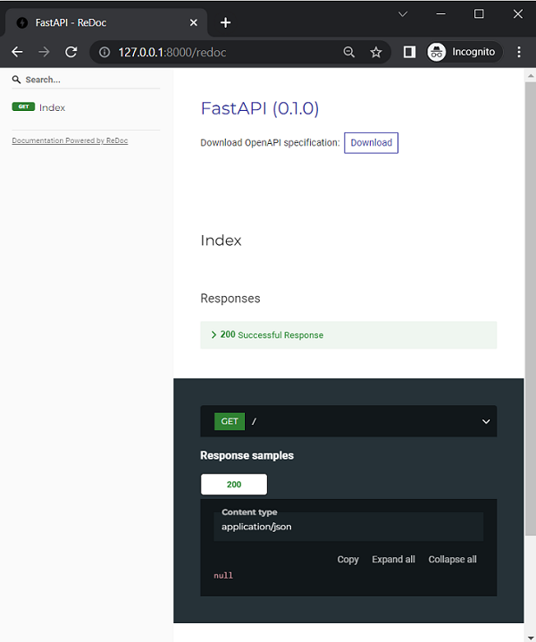
FastAPI also supports another automatic documentation method provided by Redoc
( https://github.com/Redocly/redoc).
Enter http://localhost:8000/redoc as URL in the browsers address bar.

Slide 13
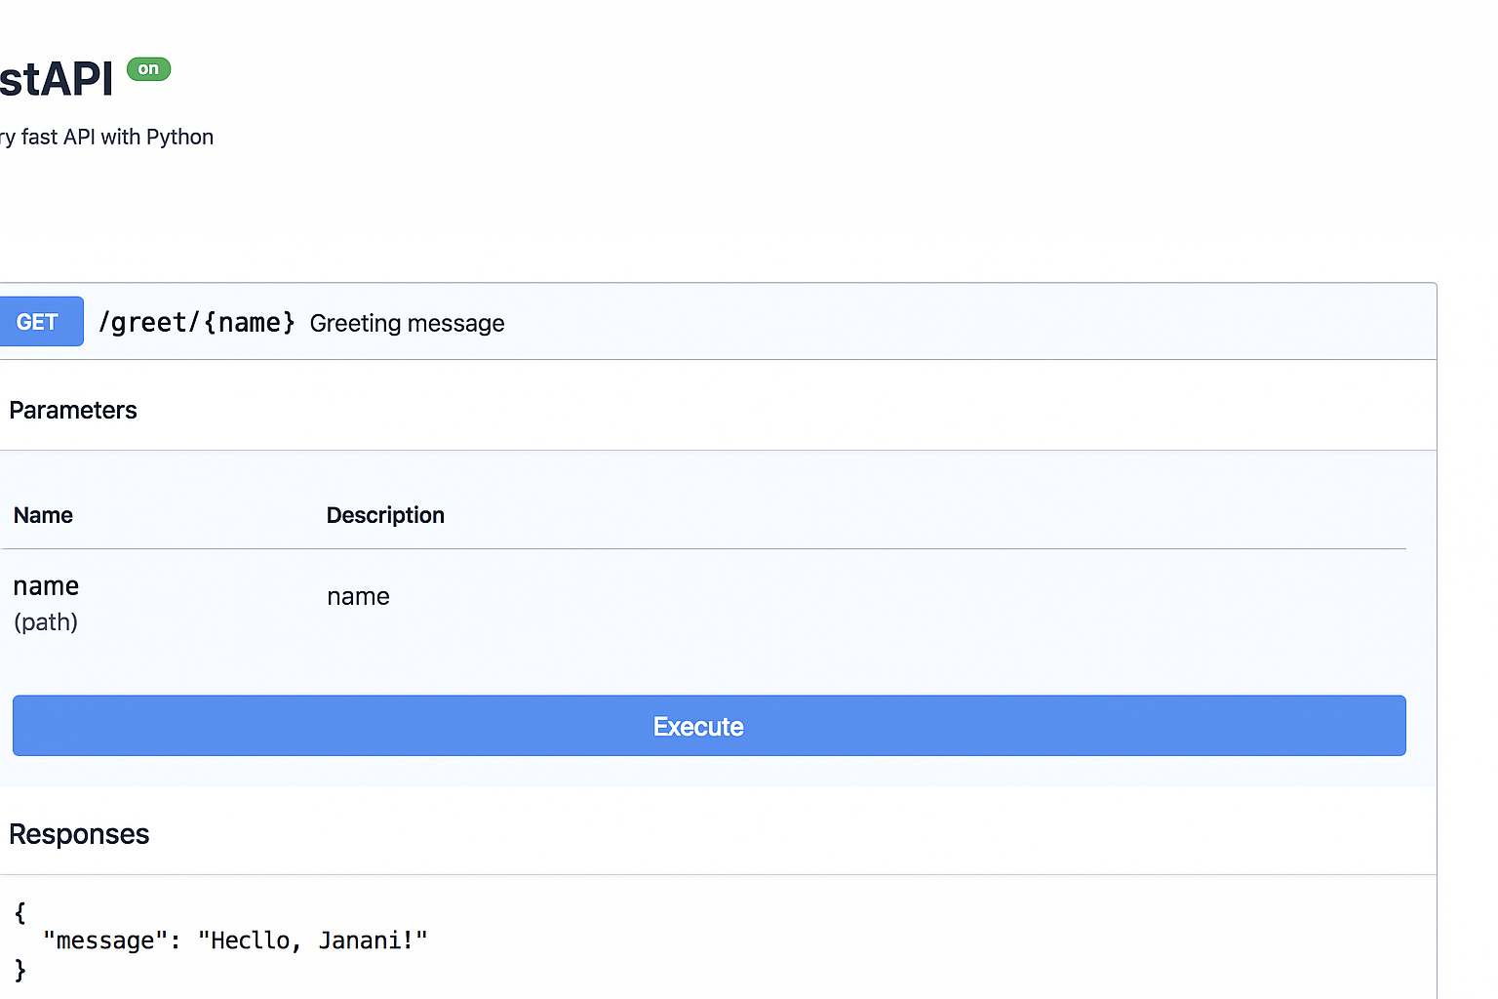
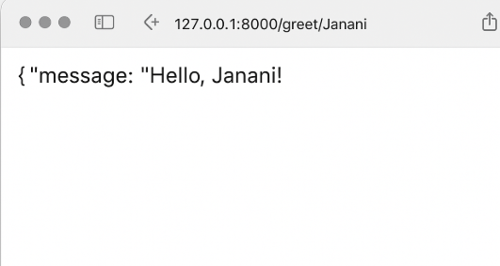
Q: Personalized Greeting!!
@app.get("/greet/{name}")
def greet(name: str):
return {"message": f"Hello, {name}!"}
http://localhost:8000/docs
http://localhost:8000/greet/Janani

Slide 14
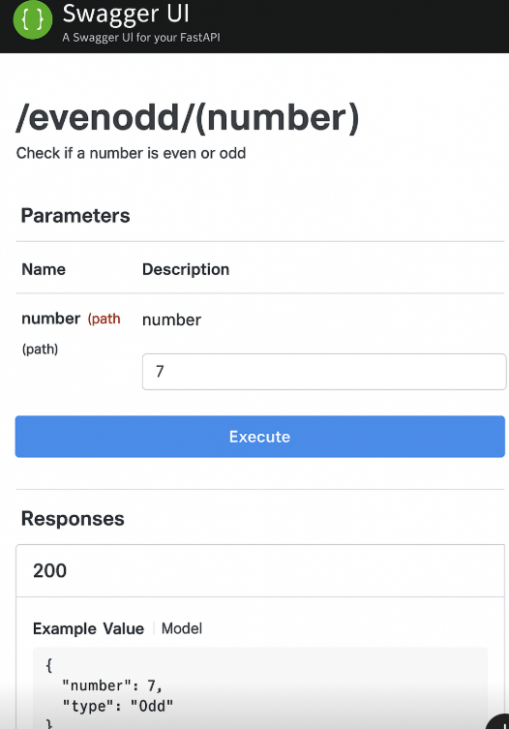
Q: Check even or odd
@app.get("/evenodd/{number}")
def even_or_odd(number: int):
return {"number": number, "type": "Even" if number % 2 == 0 else "Odd"}
http://127.0.0.1:8000/evenodd/10
{
"number": 10,
"type": "Even"
}

Slide 15
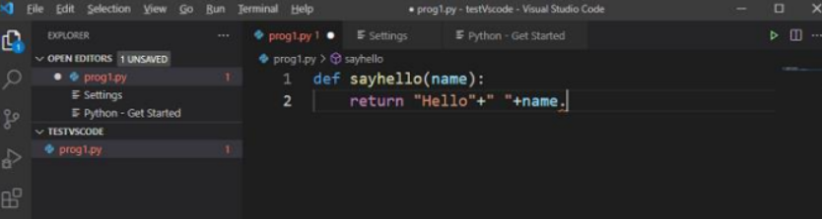
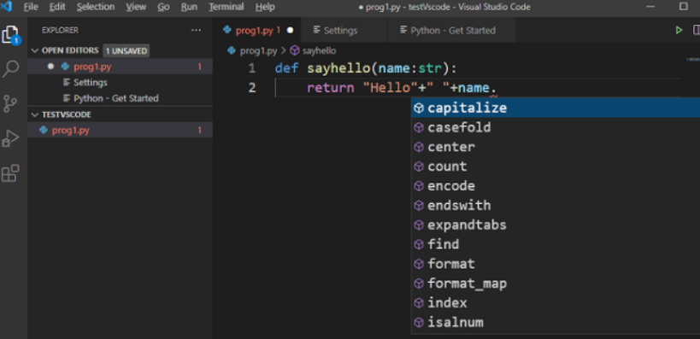
IDE
The Type Hinting feature of Python is most effectively used in almost all IDEs (Integrated Development Environments) such as PyCharm and VS Code to provide dynamic autocomplete features.
Example: sayhello(name: str) → returns "Hello <Name>". With name: str, VS Code knows name is a string.
Typing name. shows a dropdown of string methods (e.g., capitalize()).
Without type hints → no autocomplete suggestions.
Here, type hint comes handy: by adding str in the function definition, you get the full list of string methods to pick from.

Slide 16
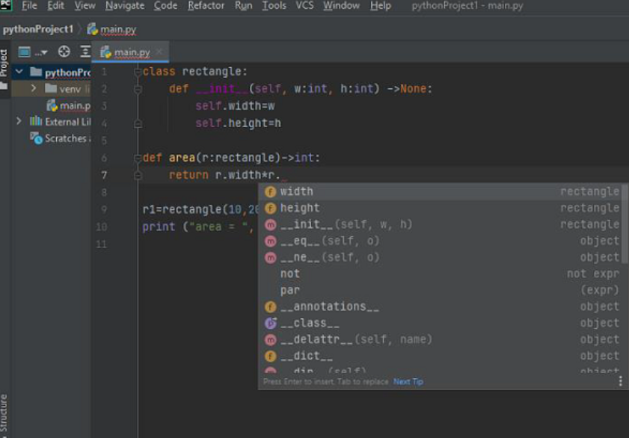
Type hints also work with user-defined class.
Eg:
class Rectangle:
def __init__(self, w: int, h: int) -> None:
self.width = w
self.height = h
def area(r: Rectangle) -> int:
return r.width * r.height
IDE (VS Code) provides autocomplete for class attributes (width, height) when r. is typed.
This helps avoid errors and speeds up coding.

Slide 17
REST Architecture
REST is an architecture style for building web applications.
It is resource-based: everything (file, image, database row) is treated as a resource.
REST Constraints
Uniform Interface – standard way to access resources
Stateless – each request is independent
Client-Server – separation of client and server
Cacheable – responses can be cached
Layered System – multiple layers between client & server
Code on Demand – server can send executable code (optional)
Advantages
Scalable
Simple
Easy to modify
Reliable
Portable
Transparent (visible interactions)
HTTP Methods in REST
POST → Create
GET → Read
PUT → Update
DELETE → Delete

Slide 18
Path Parameters
Path parameters are values that form part of the URL path itself.
They let you capture specific resources by embedding variables directly in the URL.
This helps the user to remember the application URLs more effectively. In FastAPI, it is termed a path. A path or route is the part of the URL trailing after the first /.
For example, in the following URL,
http://localhost:8000/hello/welcometoCSRbootcamp
The path or route would be
/hello/welcometoCSRbootcamp
In FastAPI, such a path string is given as a parameter to the operation decorator. The operation here refers to the HTTP verb used by the browser to send the data.
These operations include GET, PUT, etc. The operation decorator (for example, @app.get("/")) is immediately followed by a function that is executed when the specified URL is visited. In the below example −
from fastapi import FastAPI
app = FastAPI()
@app.get("/")
async def index():
return {"message": "Hello World"}
Here, ("/") is the path, get is the operation, @app.get("/") is the path operation decorator, and the index() function just below it is termed as path operation function.

Slide 19
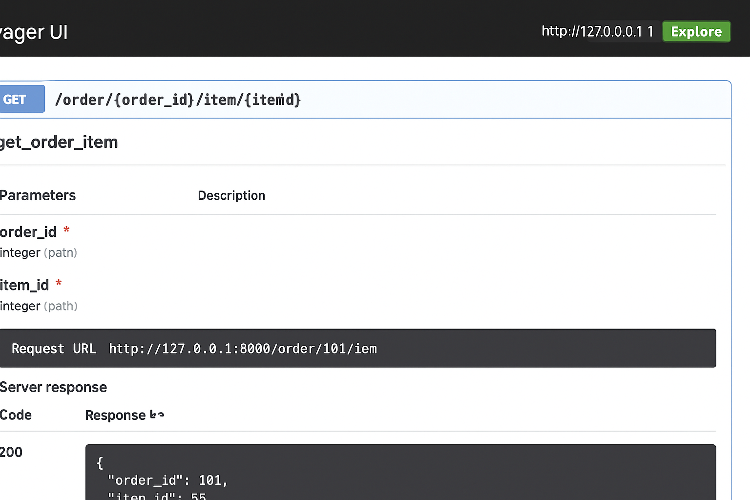
To return multiple path parameters
from fastapi import FastAPI
app = FastAPI()
@app.get("/order/{order_id}/item/{item_id}")
def get_order_item(order_id: int, item_id: int):
return {"order_id": order_id, "item_id": item_id}
http://127.0.0.1:8000/order/101/item/55
Output :
{"order_id": 101, "item_id": 55}

Slide 20
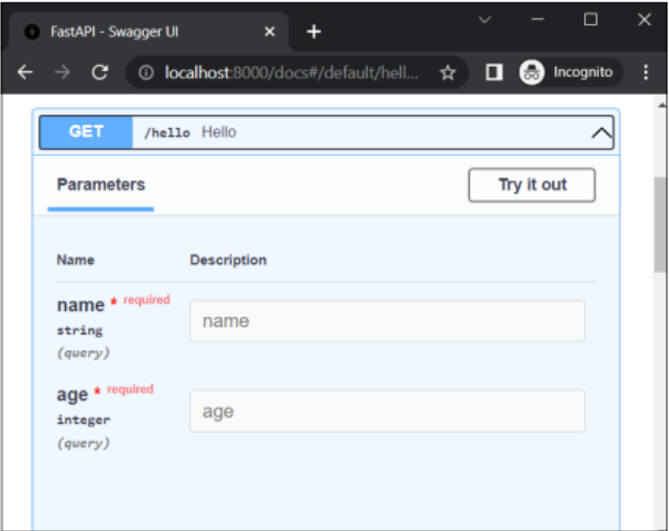
Query Parameters
A classical method of passing the request data to the server is to append a query string to the URL.
In FastAPI, query parameters are the values you pass in the URL after the ? symbol. They’re not part of the path, but extra key-value pairs.
from fastapi import FastAPI
app = FastAPI()
@app.get("/hello")
async def hello(name:str, age:int):
return {"name": name, "age":age}
http://localhost:8000/hello?name=Ravi&age=20

Slide 21
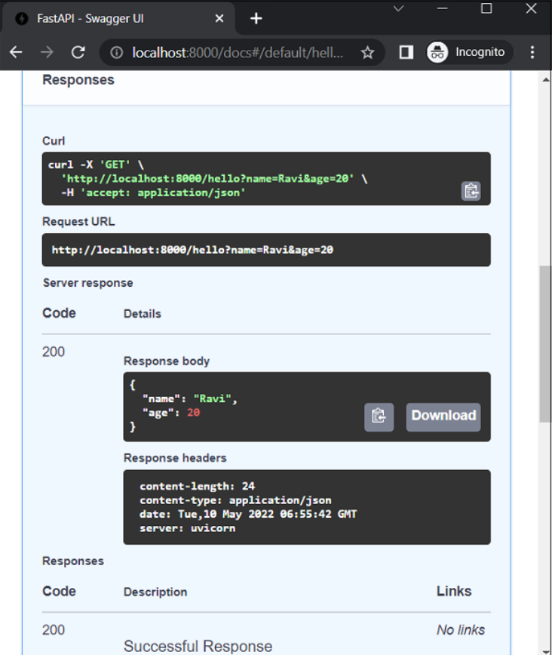
Optional Query Parameters
from fastapi import FastAPI
from typing import Optional
app = FastAPI()
@app.get("/greet/")
def greet(name: Optional[str] = "Guest"):
return {"message": f"Hello, {name}!"}
URL with Query
http://127.0.0.1:8000/greet/?name=Janani
Output: {"message": "Hello, Janani!"}
URL without Query
http://127.0.0.1:8000/greet/
Output: {"message": "Hello, Guest!"}
Query parameters are mainly used to filter, search, sort, or customize the response without changing the endpoint path.

Slide 22
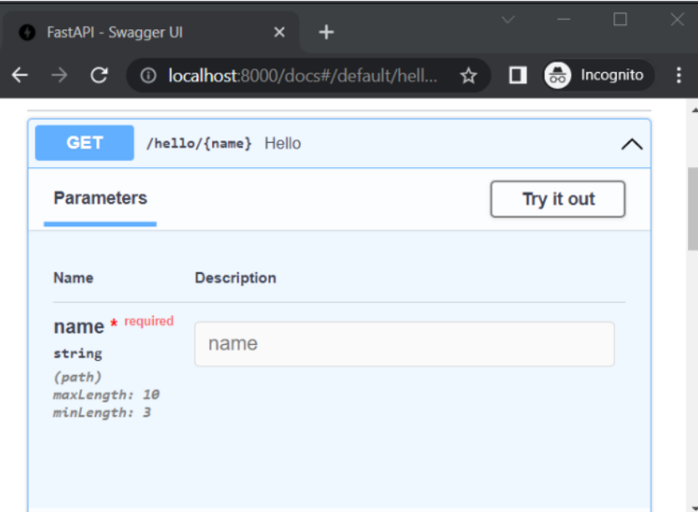
Parameter Validation
It is possible to apply validation conditions on path parameters as well as query parameters of the URL.
In order to apply the validation conditions on a path parameter, you need to import the Path class.
In addition to the default value of the parameter, you can specify the maximum and minimum length in the case of a string parameter.
from fastapi import FastAPI, Path
app = FastAPI()
@app.get("/hello/{name}")
async def hello(name:str=Path(...,min_length=3, max_length=10)):
return {"name": name}
If the browsers URL contains the parameter with a length less than 3 or more than 10, as in (http://localhost:8000/hello/Tutorialspoint), there will be an appropriate error message.
The OpenAPI docs also shows the validation applied.

Slide 23
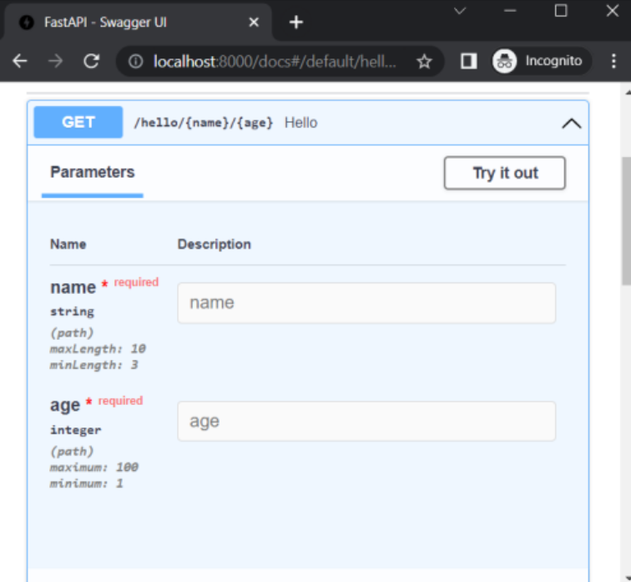
Validation rules can be applied on numeric parameters too, using the operators as given below −
gt − greater than
ge − greater than or equal
lt − less than
le − less than or equal
Let us modify the above operation decorator to include age as a path parameter and apply the validations.
from fastapi import FastAPI, Path
app = FastAPI()
@app.get("/hello/{name}/{age}")
async def hello(*, name: str=Path(...,min_length=3 , max_length=10), age: int = Path(..., ge=1, le=100)):
return {"name": name, "age":age}
In this case, validation rules are applied for both the parameters name and age. If the URL entered is http://localhost:8000/hello/hi/110, then the JSON response shows some explanations for validation failure.

Slide 24
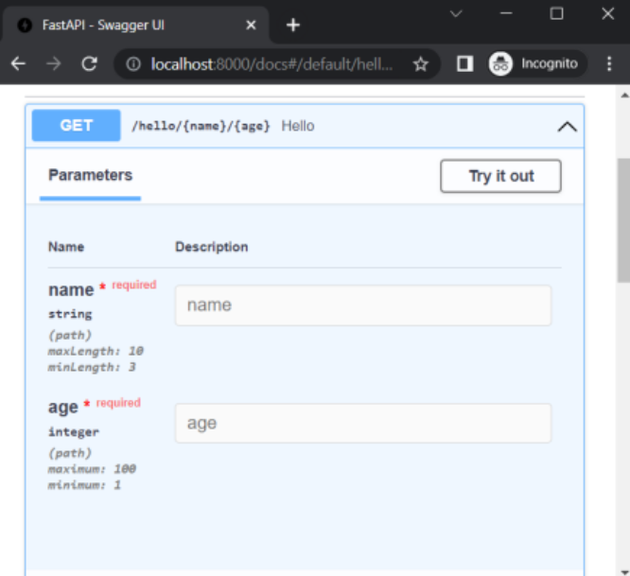
The query parameters can also have the validation rules applied to them. You have to specify them as the part of arguments of Query class constructor.
Let us add a query parameter called percent in the above function and apply the validation rules as ge=0 (i.e., greater than equal to 0) and lt=100 (less than or equal to 100)
from fastapi import FastAPI, Path, Query
@app.get("/hello/{name}/{age}")
async def hello(*, name: str=Path(...,min_length=3 ,max_length=10), \
age: int = Path(..., ge=1, le=100), \
percent: float=Query(..., ge=0, le=100)):
return {"name": name, "age":age}
If the URL entered is http://localhost:8000/hello/Ravi/20?percent=79, then the browser displays following JSON response −
Output: {"name":"Ravi","age":20}
FastAPI correctly identifies percent as a query parameter with validation conditions applied. It is reflected in the OpenAPI documentation as follows −

Slide 25
Pydantic Model
Pydantic is a Python library used by FastAPI for data validation.
It ensures input data (like JSON in requests) matches the expected structure & type.
Uses Python type hints(version 3.6 onwards) and validators.
Pydantic defines BaseModel class. It acts as the base class for creating user defined models.
Following code defines a Student class as a model based on BaseModel.
from pydantic import BaseModel
class User(BaseModel):
name: str
age: int
email: str
User is a model.
It expects name (string), age (integer), email (String)

Slide 26
Using Pydantic in FastAPI
from fastapi import FastAPI
from pydantic import BaseModel
app = FastAPI()
class User(BaseModel):
name: str
age: int
email: str
@app.post("/users/")
def create_user(user: User):
return {"message": f"User {user.name} created!", "data": user}
Sending this request
{
"name": "Janani",
"age": 23,
"email": "janani@example.com"
}
{
"message": "User Janani created!",
"data": {
"name": "Janani",
"age": 23,
"email": "janani@example.com"
}
}
❌ If data is invalid (e.g., age: "twenty"), FastAPI auto-returns a 400 error with validation details.

Slide 27
Adding Validation Rules
from pydantic import BaseModel, Field, EmailStr
class User(BaseModel):
name: str = Field(..., min_length=3, max_length=20)
age: int = Field(..., gt=0, lt=120)
email: EmailStr # built-in email validation
✅ {"name": "Janani", "age": 23, "email": "janani@example.com"} → works
❌ {"name": "J", "age": -1, "email": “123!example.com"} → validation error
Why Use Pydantic?
Ensures data safety (no invalid types).
Auto-generates Swagger docs with models.
Reduces boilerplate code (no manual validation needed).

Slide 28
Request Body
We shall now use the Pydantic model object as a request body of the client's request. We will be using POST operation decorator for the purpose.
import uvicorn
from fastapi import FastAPI
from typing import List
from pydantic import BaseModel, Field
app = FastAPI()
class Student(BaseModel):
id: int
name :str = Field(None, title="name of student", max_length=10)
subjects: List[str] = []
@app.post("/students/")
async def student_data(s1: Student):
return s1
The URL receives an object of Student class as Body parameter from the client's request. To test this route, start the Uvicorn server and open the Swagger UI documentation in the browser by visiting http://localhost:8000/docs

Slide 29
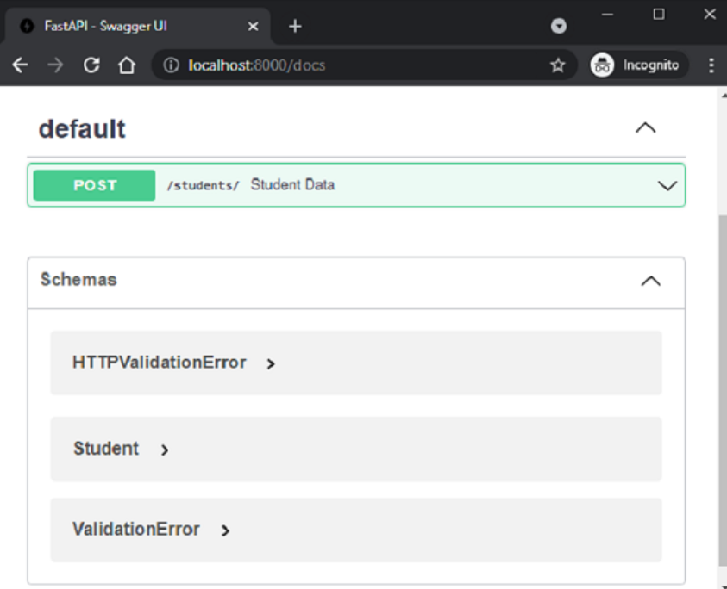
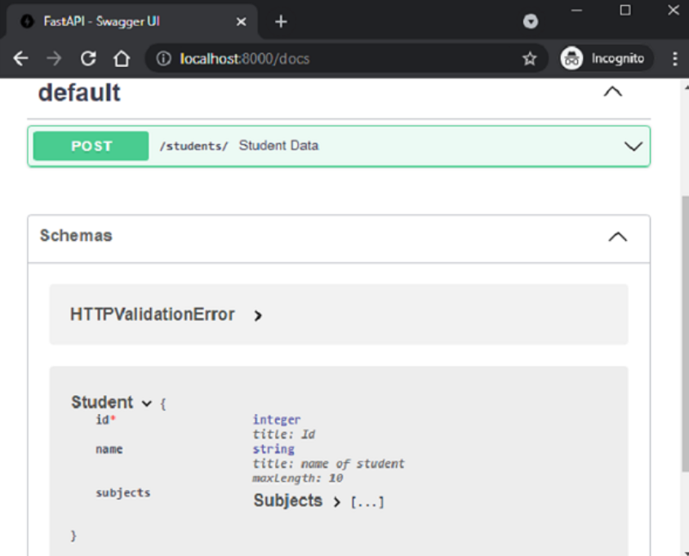
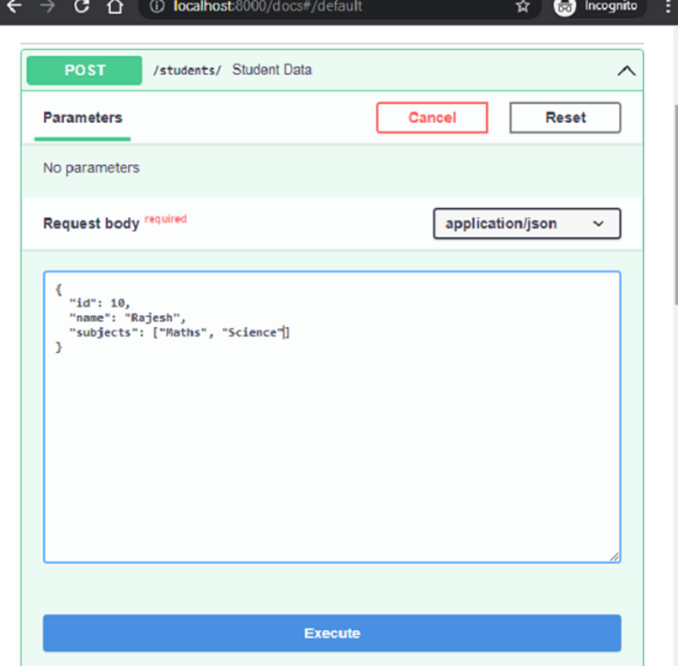
The documentation identifies that "/students/" route is attached with student_data() function with POST method. Under the schemas section the Student model will be listed.
Click the Try it out button to fill in the test values in the request body.

Slide 30
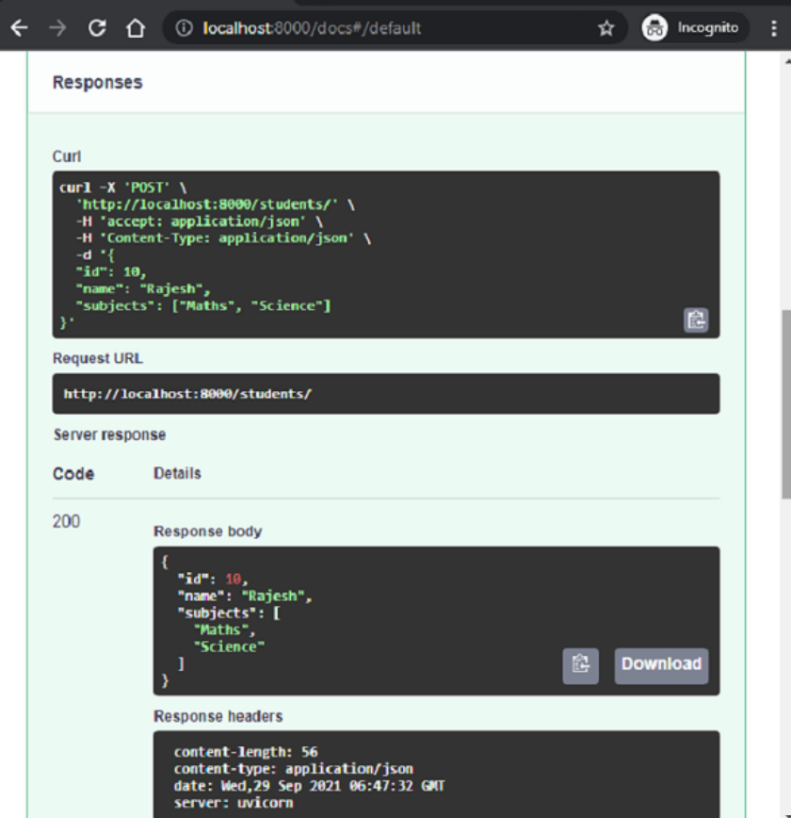
Click the Execute button and get the servers response values.

Slide 31
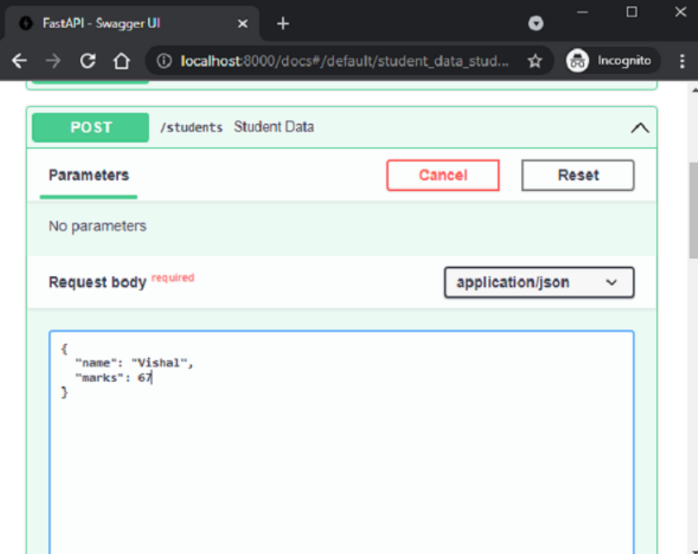
Using Body Parameters in FastAPI
Pydantic models usually define request body automatically.
But you can also use singular values for attributes.
For this, use the Body class from fastapi.
import uvicorn
from fastapi import FastAPI, Body
@app.post("/students")
async def student_data(name:str=Body(...),
marks:int=Body(...)):
return {"name":name,"marks": marks}

Slide 32
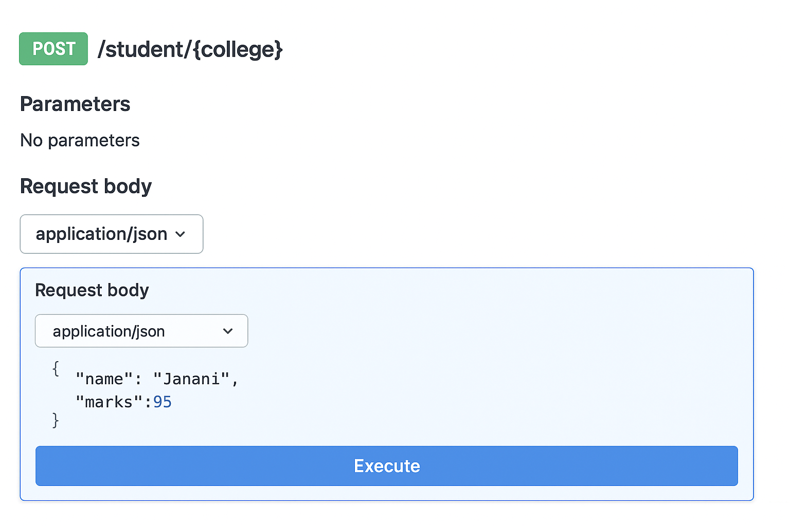
Mixing Path, Query & Body Parameters in FastAPI
FastAPI allows combining path, query, and body parameters.
from fastapi import FastAPI, Query
from pydantic import BaseModel
app = FastAPI()
class Student(BaseModel):
name: str
marks: int
@app.post("/student/{college}")
def student_data(
college: str,
age: int = Query(...),
student: Student = Body(...) // student: Student = ...
):
return {"college": college, "age": age, "student": student}

Slide 33
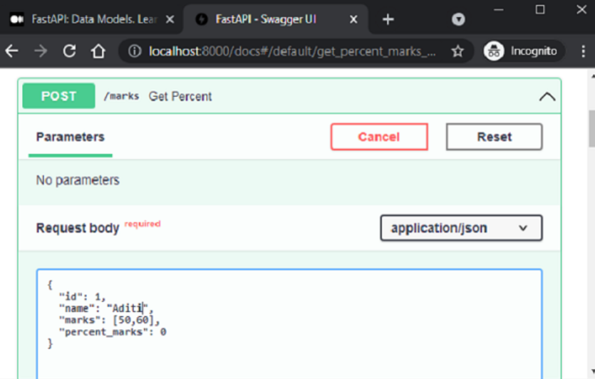
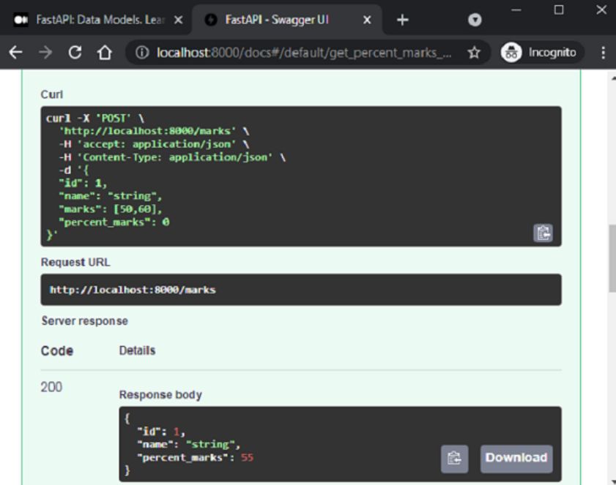
Response Model
An operation function returns JSON response (string, number, list, dict, or Pydantic
model). We can use response_model in decorator to return a model object.
response_model ensures:
Data is validated against model.
JSON Schema is added in OpenAPI docs.
Output can be formatted (select specific fields).
from typing import List
from fastapi import FastAPI
from pydantic import BaseModel, Field
app = FastAPI()
class student(BaseModel):
id: int
name :str = Field(None, title="name of student", max_length=10)
marks: List[int] = []
percent_marks: float
class percent(BaseModel):
id:int
name :str = Field(None, title="name of student", max_length=10)
percent_marks: float
@app.post("/marks", response_model=percent)
async def get_percent(s1:student):
s1.percent_marks=sum(s1.marks)/2
return s1

Slide 34
Dependencies
The built-in dependency injection system of FastAPI makes it possible to integrate components easier when building your API.
In programming, Dependency injection refers to the mechanism where an object receives other objects that it depends on.
Dependencies are reusable pieces of logic that can be shared across multiple endpoints.
They are functions or classes injected automatically by FastAPI when a request is processed.
Why? Or its Advantages.
reuse the same shared logic
share database connections
enforce authentication and security features
EG:
from fastapi import Depends, FastAPI
app = FastAPI()
def common_query(q: str = None):
return {"q": q}
@app.get("/items/")
def read_items(query: dict = Depends(common_query)):
return query
Depends() tells FastAPI to run common_query() and pass its result to the endpoint.

Slide 35
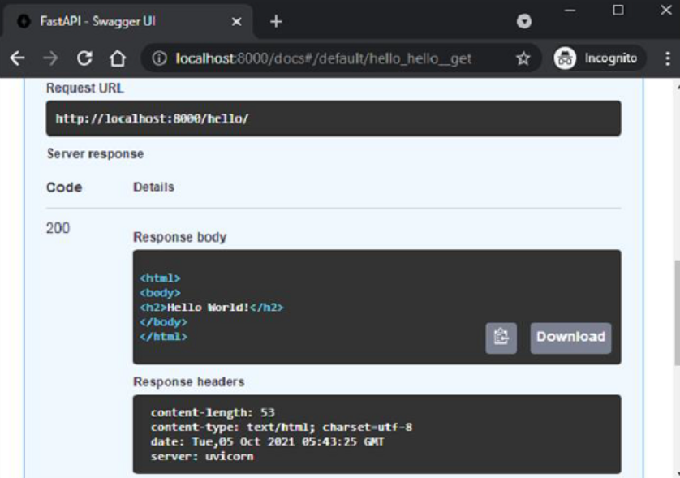
Templates
On examining the API docs, it can be seen that the server's response body is in HTML.
HTML Response in FastAPI
By default, FastAPI returns JSON responses.
Can be changed to HTML response using HTMLResponse.
HTMLResponse is available in fastapi.responses.
Use response_class=HTMLResponse in the decorator.
Return a string of HTML code from the function.
from fastapi.responses import HTMLResponse
from fastapi import FastAPI
app = FastAPI()
@app.get("/hello/")
async def hello():
ret='''
<html>
<body>
<h2>Hello World!</h2>
</body>
</html>
'''
return HTMLResponse(content=ret)

Slide 36
Templates
Request URL (e.g., http://localhost:8000/hello/) can render HTML in the browser.
Writing raw HTML responses directly is tedious.
Solution → Use a web template library to render prebuilt HTML pages.
A template engine merges:
Static HTML (with placeholders)
Dynamic data (e.g., from database)
FastAPI does not include a built-in template engine. You can choose any library → most popular is Jinja2.
Install Jinja2 with pip:
pip3 install jinja2
FastAPIs support for Jinja templates comes in the form of jinja2Templates class defined in fastapi.templates module.
from fastapi.templating import Jinja2Templates
To declare a template object, the folder in which the html templates are stored, should be provided as parameter. Inside the current working directory, we shall create a templates directory.
templates = Jinja2Templates(directory="templates")

Slide 37
A simple web page hello.html to render Hello World message is also put in templates folder.
<html>
<body>
<h2>Hello World!</h2>
</body>
</html>
We are now going to render html code from this page as HTMLResponse. Let us modify the hello() function as follows −
from fastapi.responses import HTMLResponse
from fastapi.templating import Jinja2Templates
from fastapi import FastAPI, Request
app = FastAPI()
templates = Jinja2Templates(directory="templates")
@app.get("/hello/", response_class=HTMLResponse)
async def hello(request: Request):
return templates.TemplateResponse("hello.html", {"request": request})

Slide 38
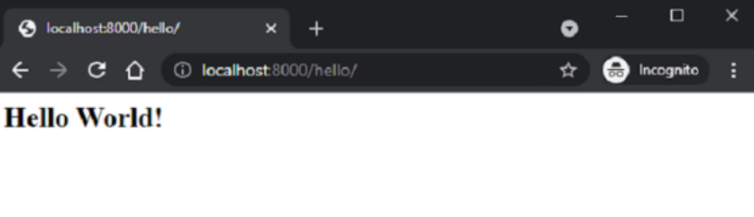
The TemplateResponse() is used to render HTML templates.
It combines:
The template file (e.g., hello.html)
The request context + dynamic data
When we start the server and visit: http://localhost:8000/hello/ Browser shows the Hello World message → rendered from hello.html.
Jinja2 Placeholders in Templates
Jinja2 allows placeholders inside HTML code. Placeholders are written in curly brackets { }.
When HTML is rendered, the template engine replaces placeholders with data.
Jinja2 provides following code elements −
{% %} Statements
{{ }} Expressions to print to the template output
{# #} − Comments which are not included in the template output
# # # − Line statements

Slide 39
The hello.html is modified as below to display a dynamic message by substituting the name parameter.
<html>
<body>
<h2>Hello {{name}} Welcome to FastAPI</h2>
</body>
</html>
The operation function hello() is also modified to accept name as a path parameter. The TemplateResponse should also include the JSON representation of name:name along with the request context.
from fastapi.responses import HTMLResponse
from fastapi.templating import Jinja2Templates
from fastapi import FastAPI, Request
app = FastAPI()
templates = Jinja2Templates(directory="templates")
@app.get("/hello/{name}", response_class=HTMLResponse)
async def hello(request: Request, name:str):
return templates.TemplateResponse("hello.html", {"request": request, "name":name})

Slide 40
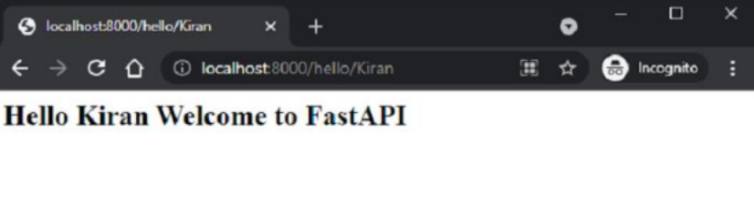
Restart the server and go to http://localhost:8000/hello/Kiran. The browser now fills the jinja2 place holder with the path parameter in this URL.
HTML Form Templates
Let us add another route "/login" to our application which renders a html template having a simple login form. The HTML code for login page is as follows −
<html>
<body>
<form action="/submit" method="POST">
<h3>Enter User name</h3>
<p><input type='text' name='nm'/></p>
<h3>Enter Password</h3>
<p><input type='password' name='pwd'/></p>
<p><input type='submit' value='Login'/></p>
</form>
</body>
</html>

Slide 41
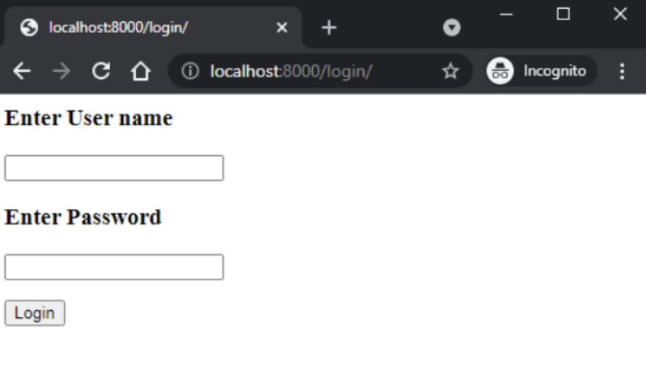
Note that the action parameter is set to "/submit" route and action set to POST. Add login() function in the main.py file as under −
@app.get("/login/", response_class=HTMLResponse)
async def login(request: Request):
return templates.TemplateResponse("login.html", {"request": request})
The URL http://localhost:8000/login will render the login form as follows −

Slide 42
Accessing Form Data
Example:
/login → Renders a login form
/submit → Processes data with POST method
FastAPI provides Form class to handle form data. Form extracts input values from submitted HTML forms.
Requires python-multipart module → install using:
pip3 install python-multipart
Add Form class to the imported resources from FastAPI
from fastapi import Form
Let us define a submit() function to be decorated by @app.post(). In order to receive the form data, declare two parameters of Form type, having the same name as the form attributes.
@app.post("/submit/")
async def submit(nm: str = Form(...), pwd: str = Form(...)):
return {"username": nm}
We can fill the form and click Submit. Browser redirects to /submit URL. JSON response with submitted data is rendered.
In Swagger API docs:
/submit route is shown.
nm and pwd appear as request body parameters.
Media type is application/x-www-form-urlencoded.

Slide 43
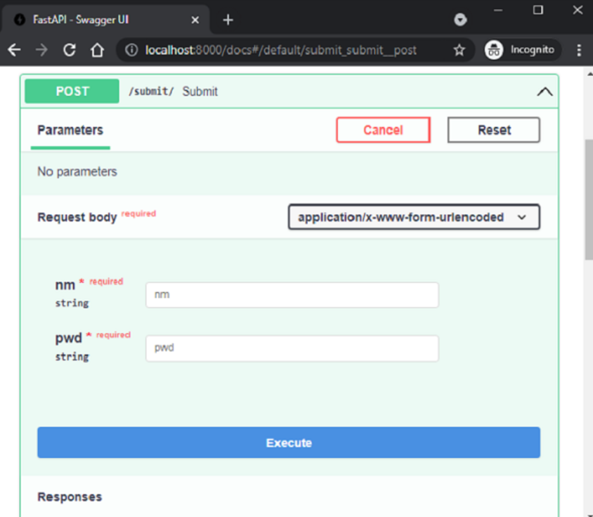
It is even possible to populate and return Pydantic model with HTML form data. In the following code, we declare User class as a Pydantic model and send its object as the server response.
from pydantic import BaseModel
class User(BaseModel):
username:str
password:str
@app.post("/submit/", response_model=User)
async def submit(nm: str = Form(...), pwd: str = Form(...)):
return User(username=nm, password=pwd)

Slide 44
Here’s a simple login form example with FastAPI handling form data.
HTML Form (login.html):
<!DOCTYPE html>
<html>
<head>
<title>Login</title>
</head>
<body>
<form action="/submit" method="post">
<label>Username:</label>
<input type="text" name="username"><br><br>
<label>Password:</label>
<input type="password" name="password"><br><br>
<button type="submit">Login</button>
</form>
</body>
</html>
2. FastAPI code
from fastapi import FastAPI, Form
from fastapi.responses import HTMLResponse
from fastapi.templating import Jinja2Templates
from fastapi.requests import Request
app = FastAPI()
templates = Jinja2Templates(directory="templates")
@app.get("/login", response_class=HTMLResponse)
def login(request: Request):
return templates.TemplateResponse("login.html", {"request": request})
@app.post("/submit")
def submit(username: str = Form(...), password: str = Form(...)):
return {"Username": username, "Password": password}

Slide 45
Uploading Files
To send a file to the server we need to use the HTML forms enctype as multipart/form-data and use the input type as the file to render a button, which when clicked allows you to select a file from the file system.
<html>
<body>
<form action="http://localhost:8000/uploader" method="POST" enctype="multipart/form-data">
<input type="file" name="file" />
<input type="submit"/>
</form>
</body>
</html>
Note that the forms action parameter to the endpoint http://localhost:8000/uploader and the method is set to POST.
This HTML form is rendered as a template with following code −

Slide 46
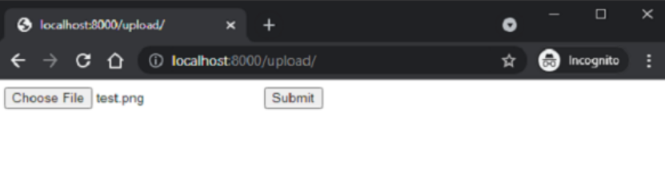
from fastapi import FastAPI, File, UploadFile, Request
import uvicorn
import shutil
from fastapi.responses import HTMLResponse
from fastapi.templating import Jinja2Templates
app = FastAPI()
templates = Jinja2Templates(directory="templates")
@app.get("/upload/", response_class=HTMLResponse)
async def upload(request: Request):
return templates.TemplateResponse("uploadfile.html", {"request": request})
Visit http://localhost:8000/upload/. You should get the form with Choose File button. Click it to open the file to be uploaded.

Slide 47
The upload operation is handled by UploadFile function in FastAPI.
from fastapi import FastAPI, File, UploadFile
import shutil
@app.post("/uploader/")
async def create_upload_file(file: UploadFile = File(...)):
with open("destination.png", "wb") as buffer:
shutil.copyfileobj(file.file, buffer)
return {"filename": file.filename}
We shall use shutil library in Python to copy the received file in the server location by the name destination.png

Slide 48
THANKYOU

